Slide 1


Slide 2
Autodesk Problem 1:
August 20, 2023
Automating material selection based on assembly and geometry setting

Slide 3
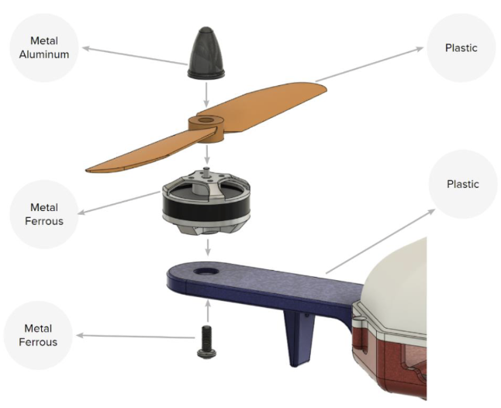
Table of Contents
Our team
Problem statement
Proposed Framework
Primary Results
Challenges and Key Learning
Future Work
Notes:
https://github.com/danielegrandi-adsk/IDETC23-Autodesk-hackathon/blob/main/Autodesk%20Hackathon%20Problem%20Statement%202023.pdf

Slide 4



Our Team: CyberPATH
Bam Thongmak pt8527@utexas.edu
Pat Wongwiset pat_wongwiset@utexas.edu

Slide 5
Problem Statement: Automating material selection
Challenges
Goals
Determine appropriate material to satisfy its function and design requirement
Improve overall quality, durability, and reliability
Leverage historical designs to provide material suggestions
Suggest better performing alternatives

Slide 6
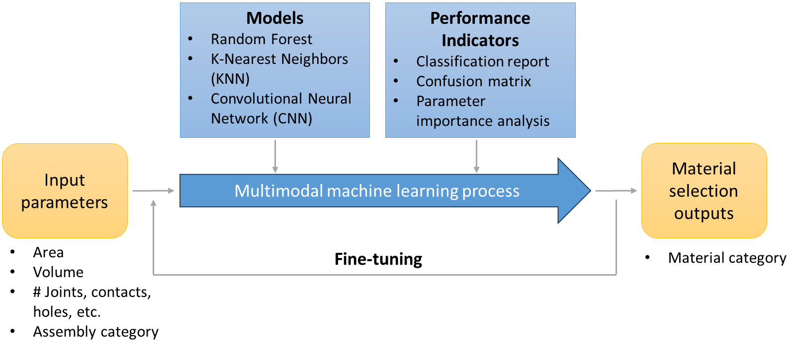
Proposed Framework
Notes:
Bam

Slide 7
Primary Results
Notes:
Bam

Slide 8
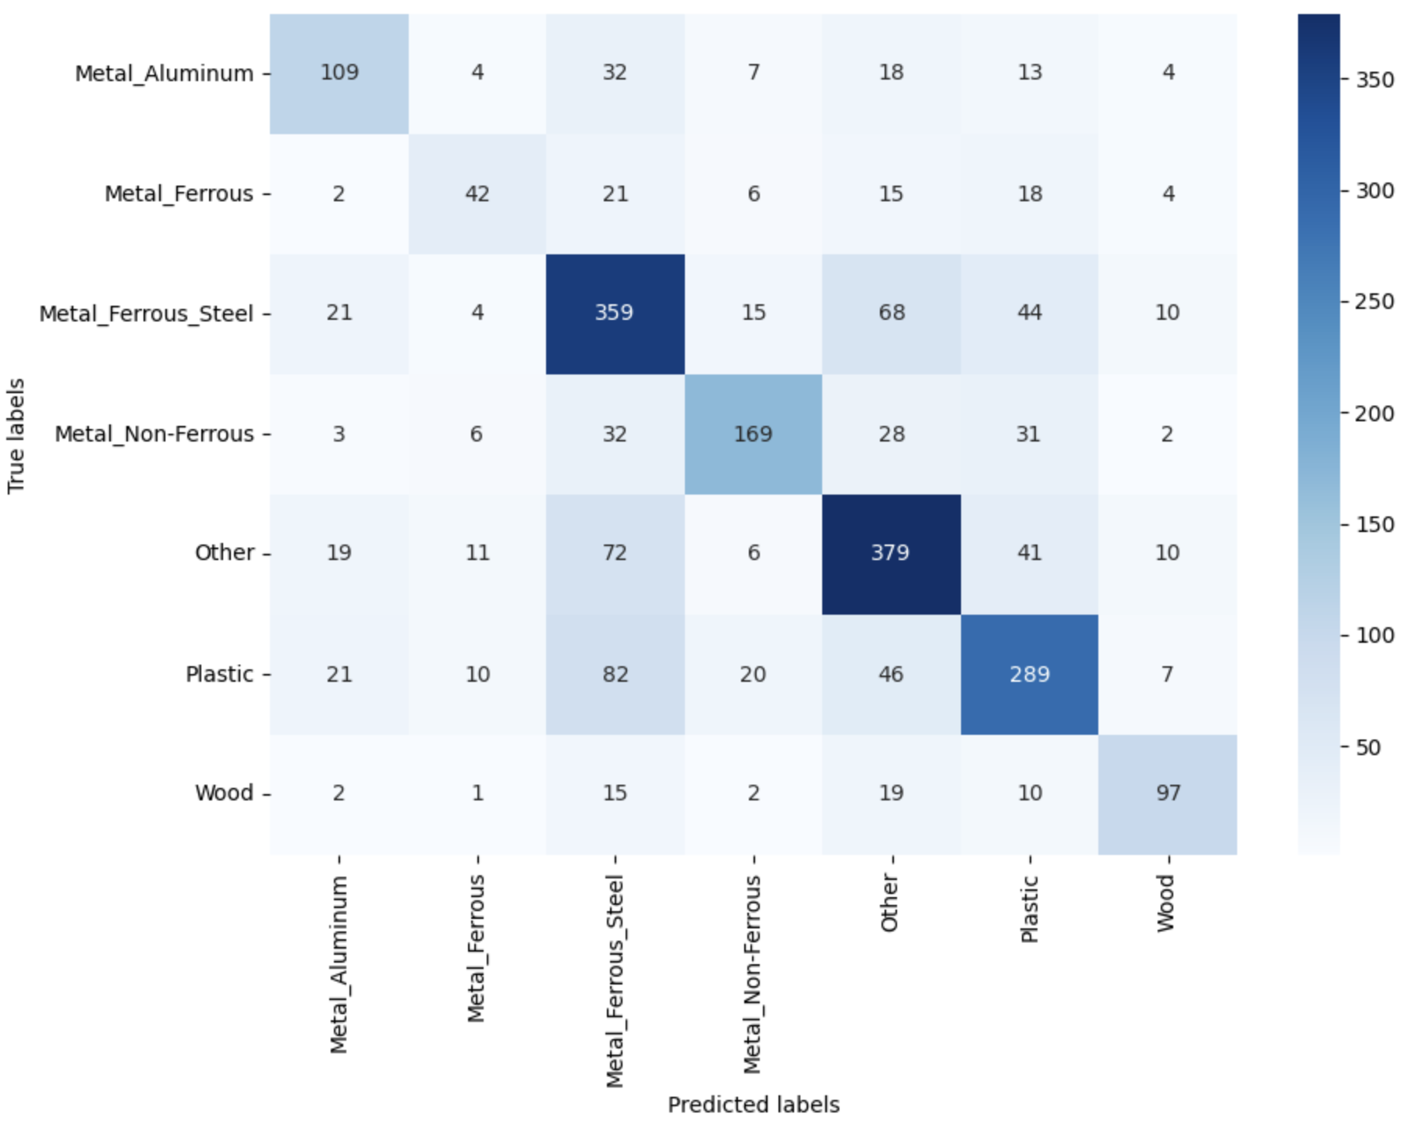
Model 1: Random Forest
Challenge 2
Notes:
Bam Random Forest: It builds decision trees on different samples and takes their majority vote for classification.
Grid search systematically tries out different combinations of hyperparameters to find the best setup for optimal model performance, such as number of trees, maximum depth, number of features, etc. → Can be computationally expensive
Interpretation of precision, recall, f1-score, support (n)
1. Precision: Percentage of correct positive predictions relative to total positive predictions.
2. Recall: Percentage of correct positive predictions relative to total actual positives.
3. F1 Score: A weighted harmonic mean of precision and recall. The closer to 1, the better the model.
F1 Score: 2 * (Precision * Recall) / (Precision + Recall)

Slide 9
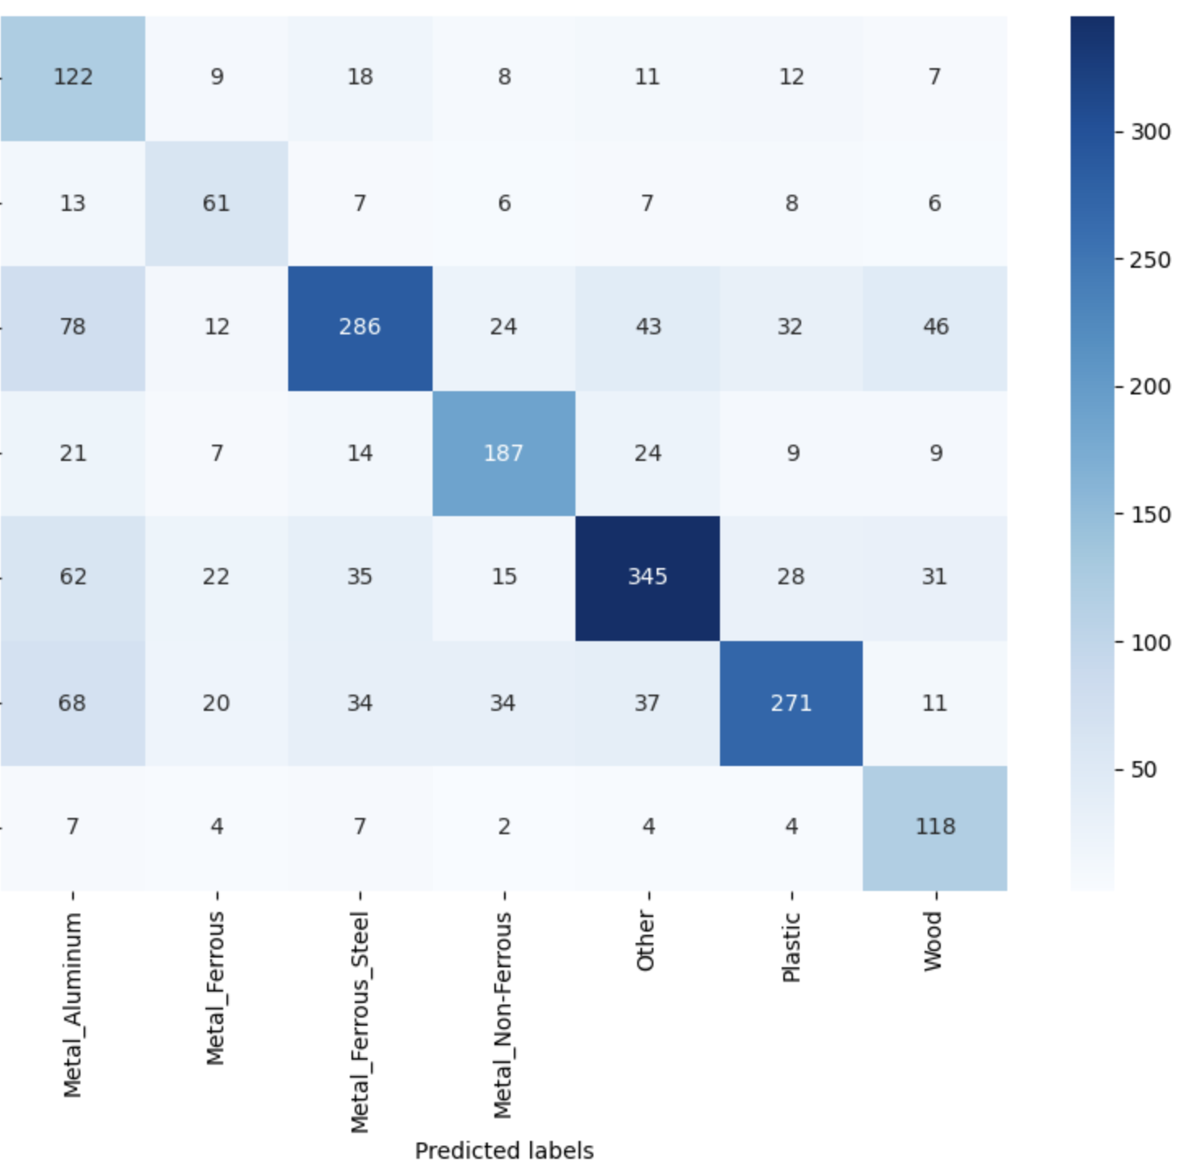
Model 1: Random Forest
Challenge 2
Apply grid search
Notes:
Bam Random Forest: It builds decision trees on different samples and takes their majority vote for classification.
Grid search systematically tries out different combinations of hyperparameters to find the best setup for optimal model performance, such as number of trees, maximum depth, number of features, etc. → Can be computationally expensive
Interpretation of precision, recall, f1-score, support (n)
1. Precision: Percentage of correct positive predictions relative to total positive predictions.
2. Recall: Percentage of correct positive predictions relative to total actual positives.
3. F1 Score: A weighted harmonic mean of precision and recall. The closer to 1, the better the model.
F1 Score: 2 * (Precision * Recall) / (Precision + Recall)

Slide 10
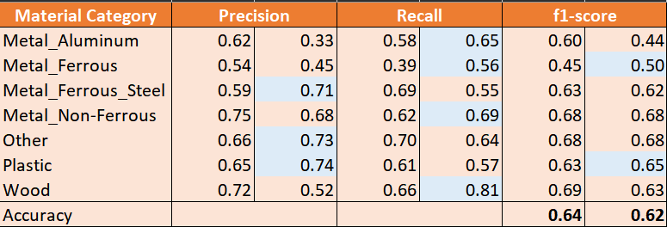
Model 1: Random Forest
Challenge 2
Apply grid search
Notes:
Bam Random Forest: It builds decision trees on different samples and takes their majority vote for classification.
Grid search systematically tries out different combinations of hyperparameters to find the best setup for optimal model performance, such as number of trees, maximum depth, number of features, etc. → Can be computationally expensive
Interpretation of precision, recall, f1-score, support (n)
1. Precision: Percentage of correct positive predictions relative to total positive predictions.
2. Recall: Percentage of correct positive predictions relative to total actual positives.
3. F1 Score: A weighted harmonic mean of precision and recall. The closer to 1, the better the model.
F1 Score: 2 * (Precision * Recall) / (Precision + Recall)

Slide 11
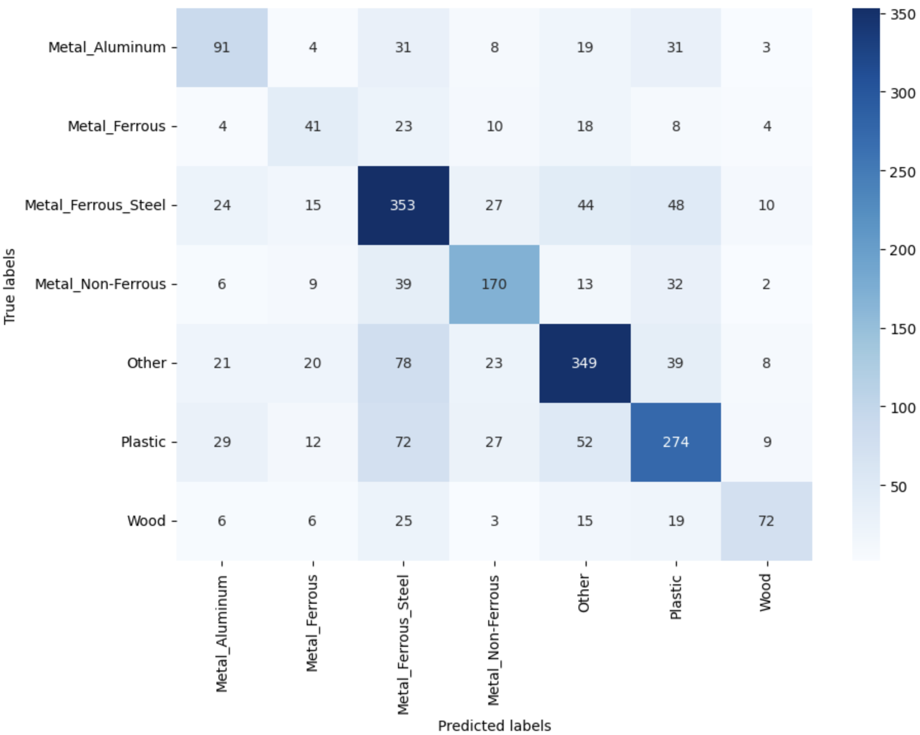
Model 2: KNN
Challenge 2
Notes:
K-nearest neighbor: Requires labeled data to make predictions (supervised learning). It uses the labels of the nearest data points to determine the label of a new data point for classification.
The weights parameter can have two common values:
uniform (default): Every one of the k neighbors has an equal vote in determining the class of the test point, irrespective of their distance from the test point.
distance: Neighbors closer to the test point will have a bigger influence on the decision than those farther away.

Slide 12
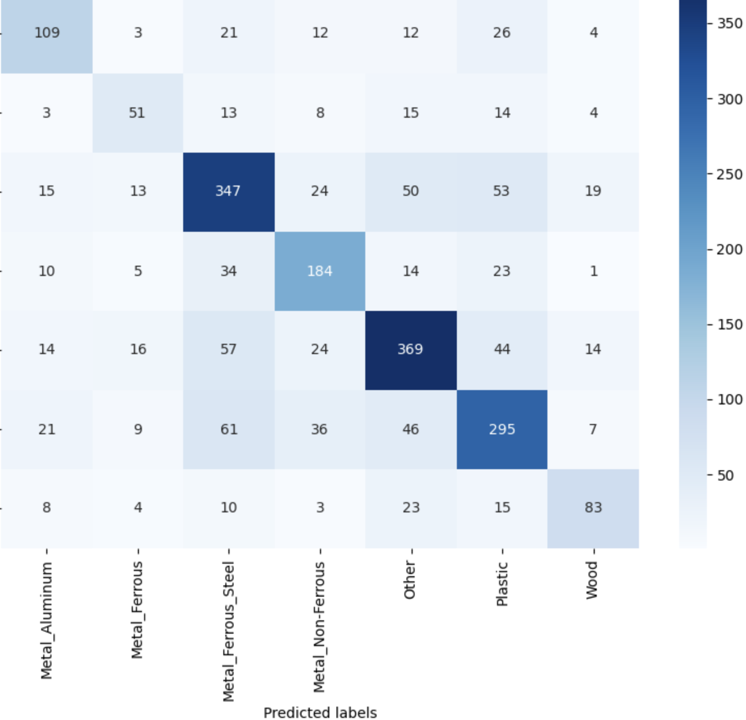
Model 2: KNN
Challenge 2
Specify weights='distance'
Notes:
K-nearest neighbor: Requires labeled data to make predictions (supervised learning). It uses the labels of the nearest data points to determine the label of a new data point for classification.
The weights parameter can have two common values:
uniform (default): Every one of the k neighbors has an equal vote in determining the class of the test point, irrespective of their distance from the test point.
distance: Neighbors closer to the test point will have a bigger influence on the decision than those farther away.

Slide 13
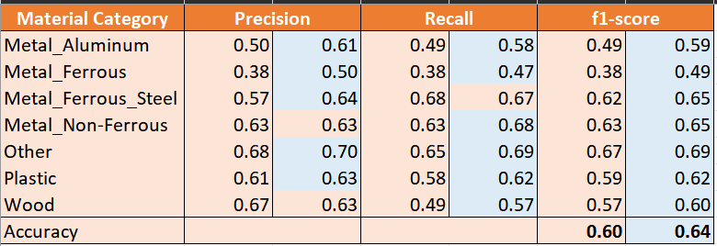
Model 2: KNN
Challenge 2
Specify weights='distance'
Notes:
K-nearest neighbor: Requires labeled data to make predictions (supervised learning). It uses the labels of the nearest data points to determine the label of a new data point for classification.
The weights parameter can have two common values:
uniform (default): Every one of the k neighbors has an equal vote in determining the class of the test point, irrespective of their distance from the test point.
distance: Neighbors closer to the test point will have a bigger influence on the decision than those farther away.

Slide 14
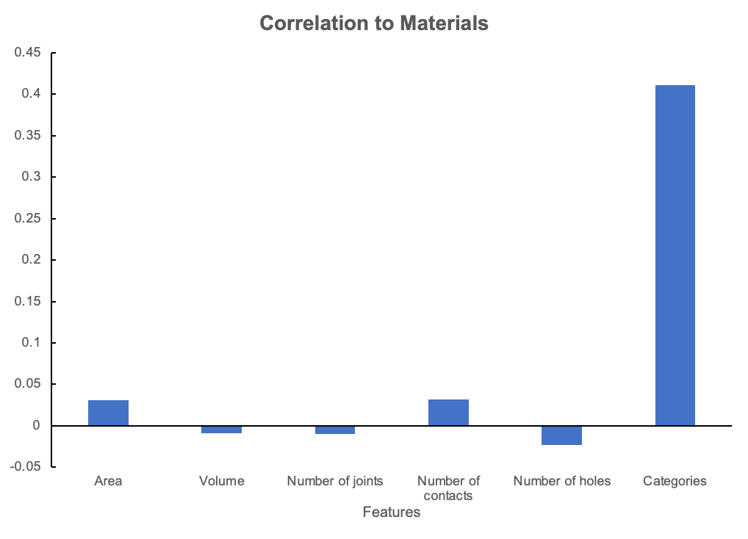
Parameter Importance Analysis
Challenge 2
Notes:
Pat: Correlation to define parameter importance → Category is the most important with highest corr → If looking in to this feature → There are over 70 features in this → All could create positive and negative to classification

Slide 15
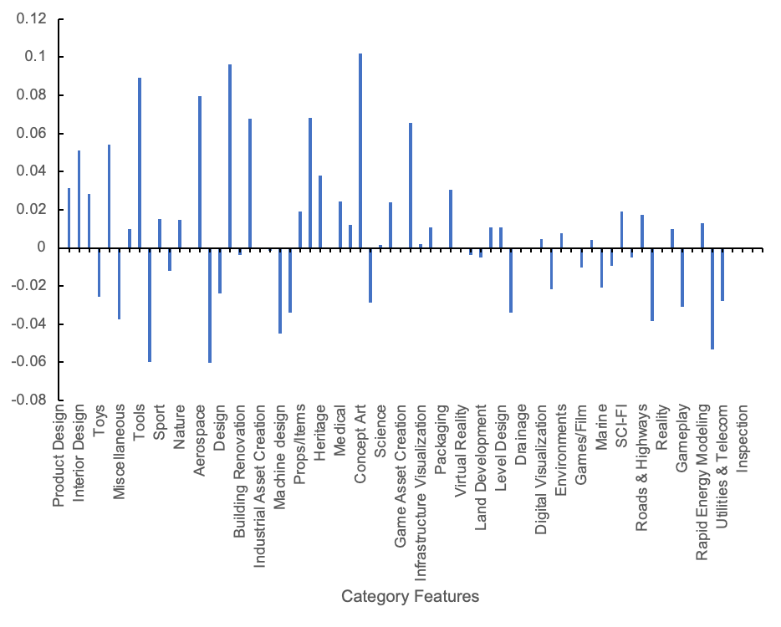
Parameter Importance Analysis
Challenge 2
Notes:
Pat

Slide 16
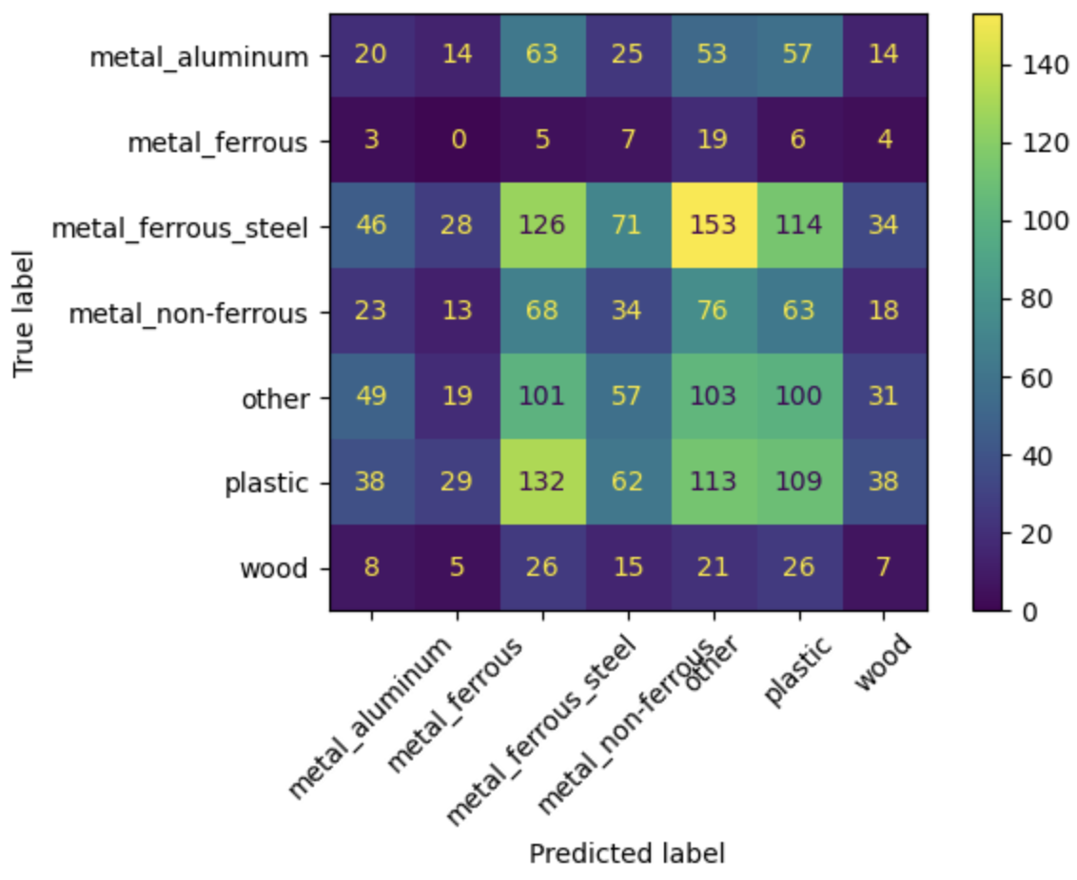
Model 3: CNN
Convolutional Neural Network (CNN)
Challenge 2
CNN Model 1: kernel_size = (3,3)
Notes:
Pat

Slide 17
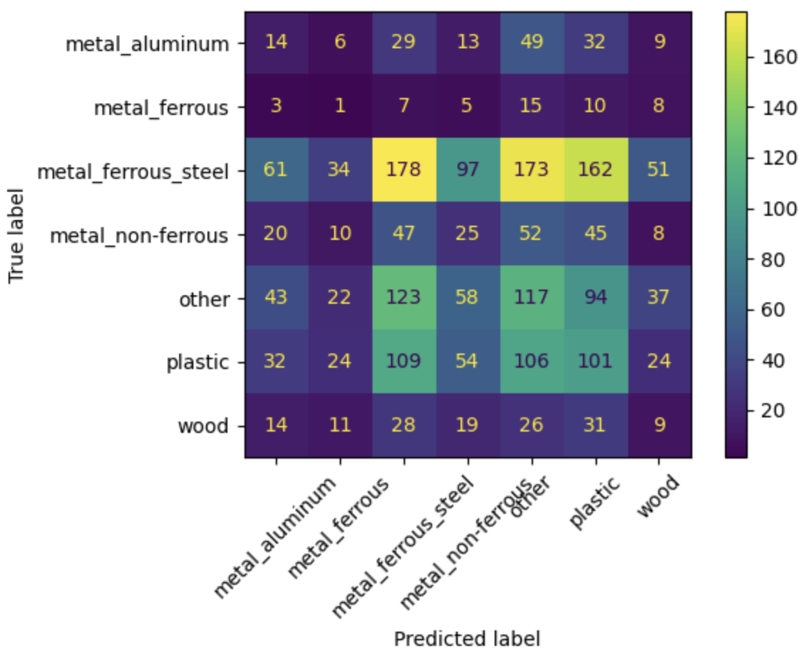
Model 3: CNN
Convolutional Neural Network (CNN)
Challenge 2
CNN Model 1: kernel_size = (3,3)
CNN Model 2: kernel_size = (5,5)
Notes:
Pat

Slide 18
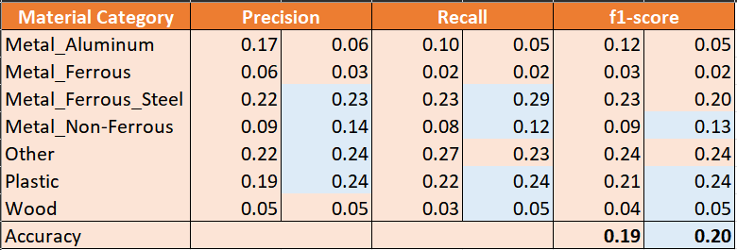
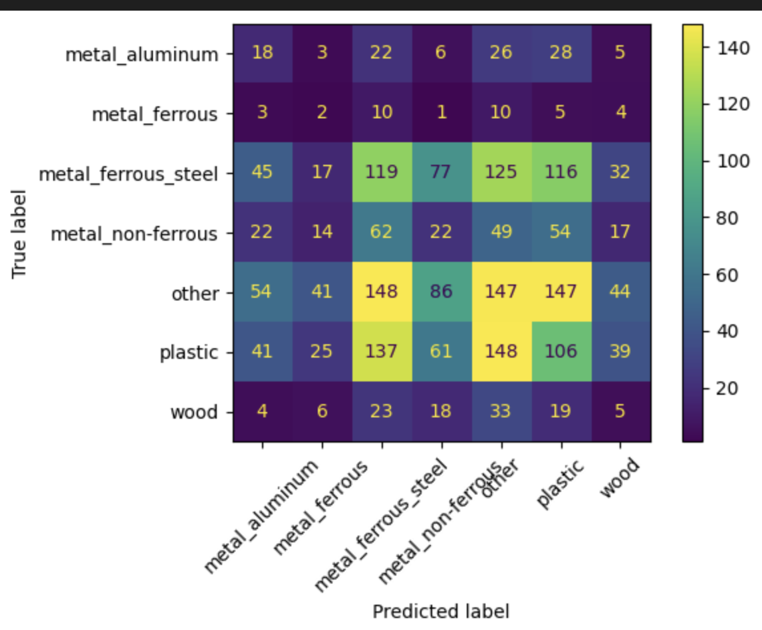
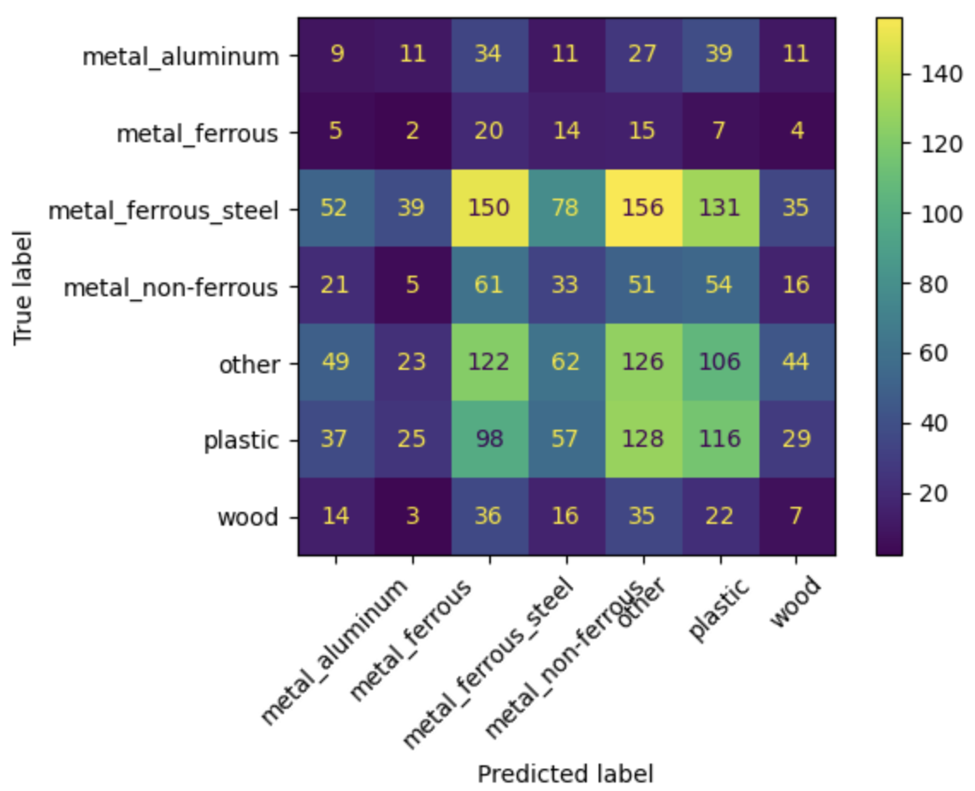
Model 3: CNN
Convolutional Neural Network (CNN)
Challenge 2
CNN Model 1: kernel_size = (3,3)
CNN Model 2: kernel_size = (5,5)
Notes:
Pat

Slide 19
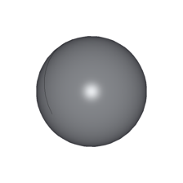
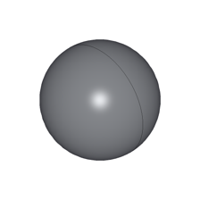
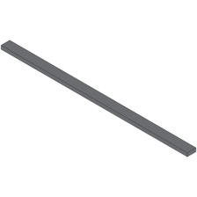

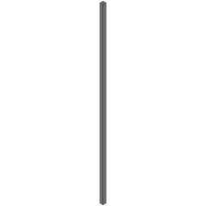
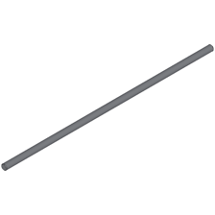
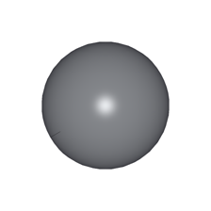

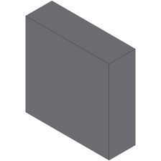
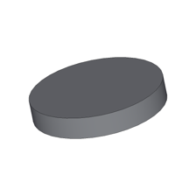
Model 3: CNN
Challenges in training this model
The model contains similar shapes of geometry in different materials
The camera setting of given .png pictures are not similar
Additional image-preprocessing may be useful to improve the accuracy
Each CNN model took very long to train (over 16 min) compared to other model methods
Challenge 2
General geometry parts found in multiple materials
Notes:
Pat:+We did not start at higher kernel though we have good resolution since the process took very long to complete

Slide 20
Challenges and Key Learning
Challenges
Key Learning items
The ensemble of multimodal framework may not apply well, given our selected models
Difficulties in finding features with reasonable correlation to the target feature
One model performed significantly better than the others
Add more parameters to the better performing model
Add other models
Brainstorming about feature selection and processing could guide us to a good start of feature searching
Notes:
Bam: Given our combination of models, the ensemble multi-model framework doesn’t apply well because the result is biased towards the better performing model → 1) adding more parameters with the better performing one provides a better result than combining models 2) expanding the scope of the model

Slide 21
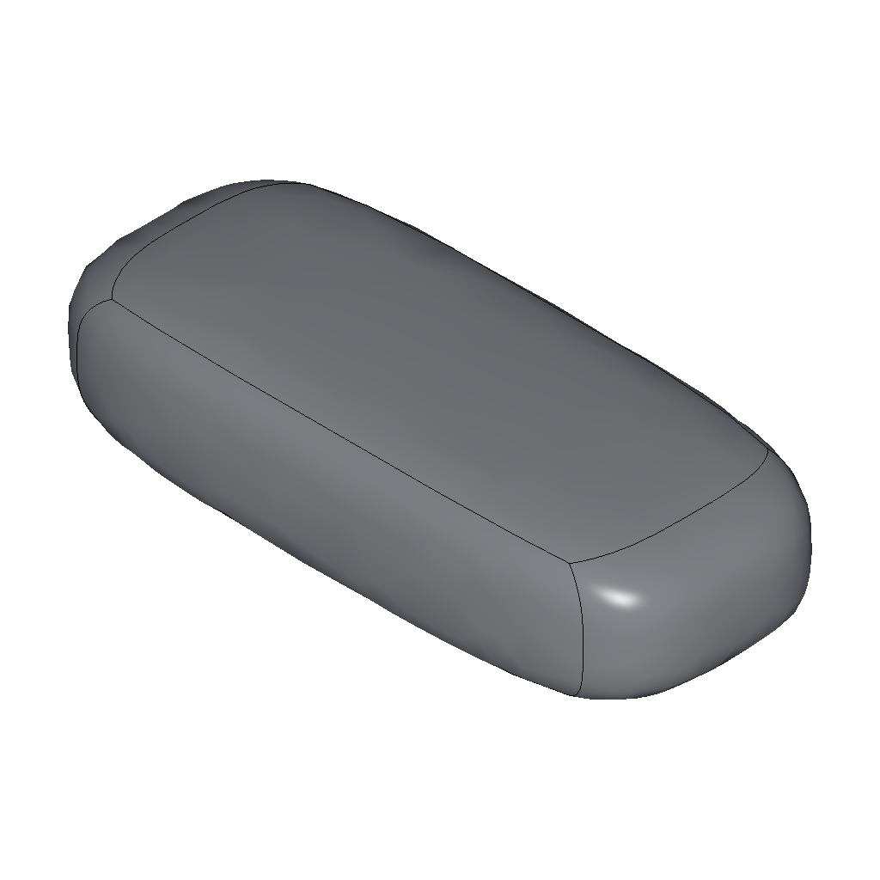
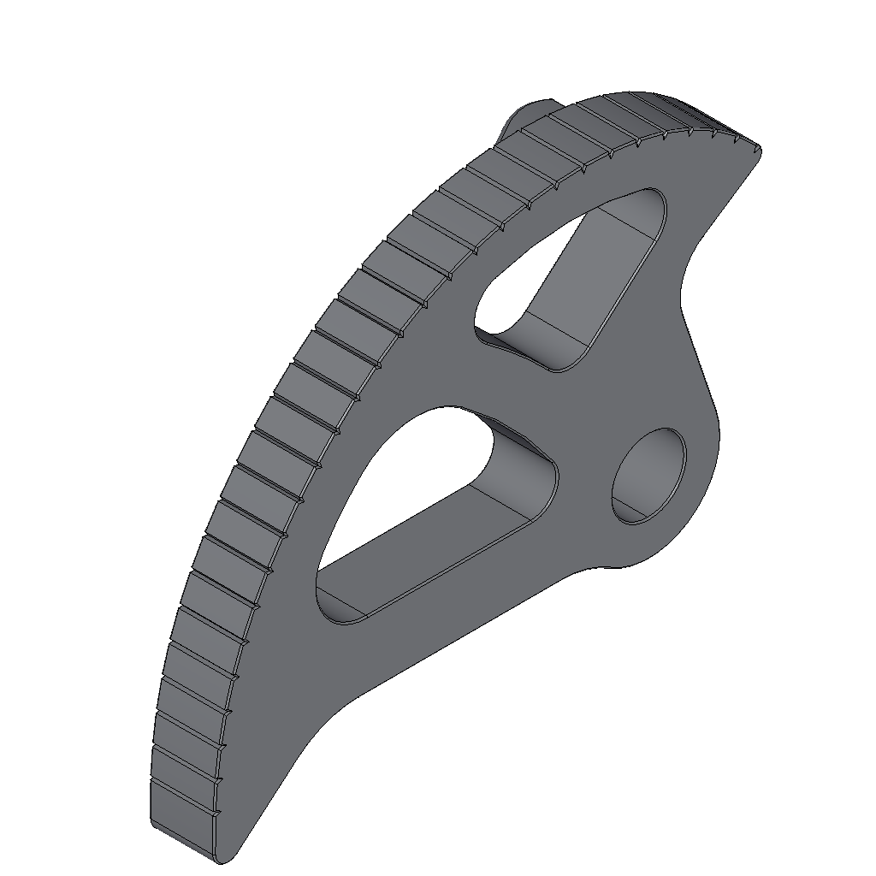
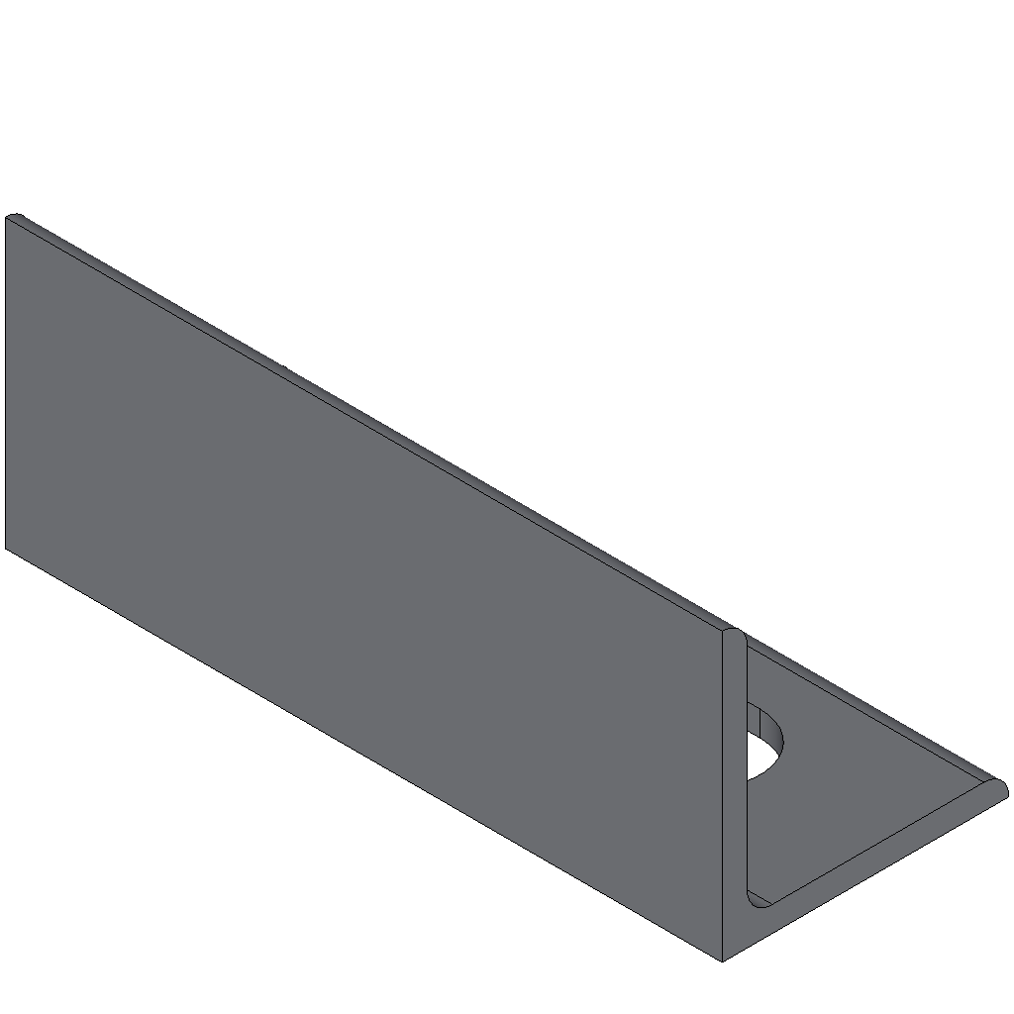
Future Work: Improving library generation
Current
Future
Use names of the bodies as an indication of unique data point
Disregard other useful data points, which have general name i.e. ‘BodyX’
Classify the unique data points based on the geometry
Example of Parts named ‘BodyX’
Notes:
Pat: Pawłowski M, Wróblewska A, Sysko-Romańczuk S. Effective Techniques for Multimodal Data Fusion: A Comparative Analysis. Sensors. 2023; 23(5):2381. https://doi.org/10.3390/s23052381
Late fusion—all the modalities are learned independently and are combined right before the model makes a decision. Early fusion—combines all modalities and then learns the model. The choice of data fusion technique is crucial for maximizing the performance of the multimodal model.
Other important future work:
Library Generation: How to create library more efficiently → Currently, excluding general name to reduce the complex of the library → Should create library based on the shape/geometry instead

Slide 22
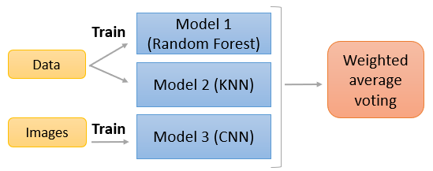
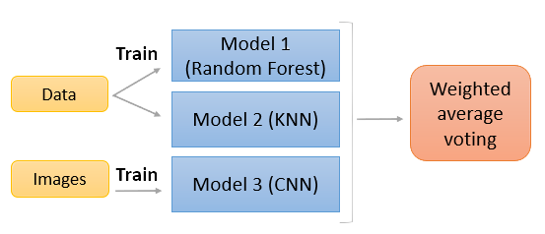
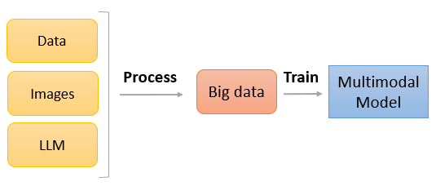
Future Work: Multimodal Data Fusion Investigation
Late Fusion
Early Fusion
Notes:
Pat: Pawłowski M, Wróblewska A, Sysko-Romańczuk S. Effective Techniques for Multimodal Data Fusion: A Comparative Analysis. Sensors. 2023; 23(5):2381. https://doi.org/10.3390/s23052381
Late fusion—all the modalities are learned independently and are combined right before the model makes a decision. Early fusion—combines all modalities and then learns the model. The choice of data fusion technique is crucial for maximizing the performance of the multimodal model.
Other important future work:
Library Generation: How to create library more efficiently → Currently, excluding general name to reduce the complex of the library → Should create library based on the shape/geometry instead

Slide 23
Thank you! Q&A

